Slide 1
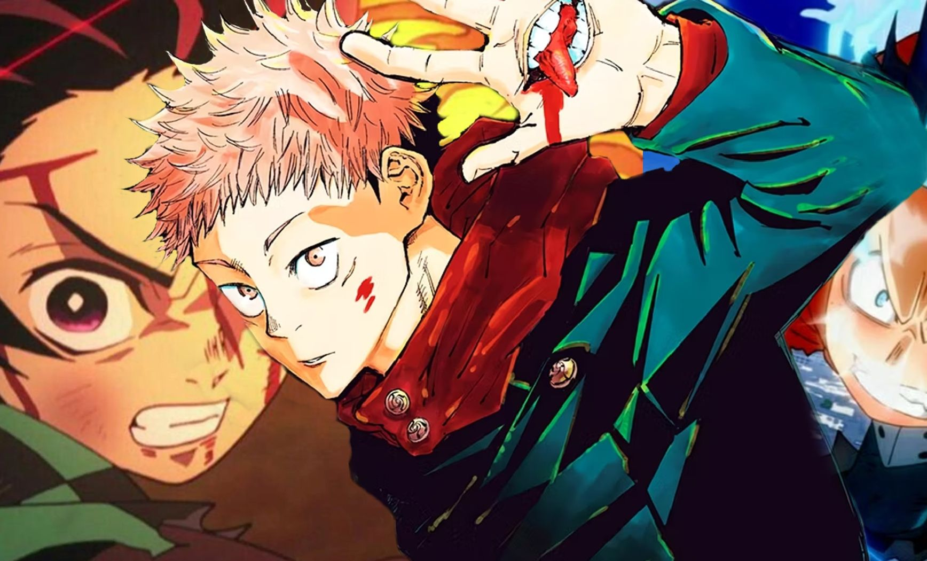
SECOND MEETING: ALL ABOUT ACTION!
10/7/2024

Slide 2
WHAT IS ACTION ANIME?
Action anime, or action shows in general, predominantly feature fight scenes, chase sequences, shootouts, explosions, and other high-stakes events.
Examples:
Hajime no Ippo (boxing)
Initial D (racing)
Magi (magic and swordplay)
Gundam (giant robots)

Slide 3
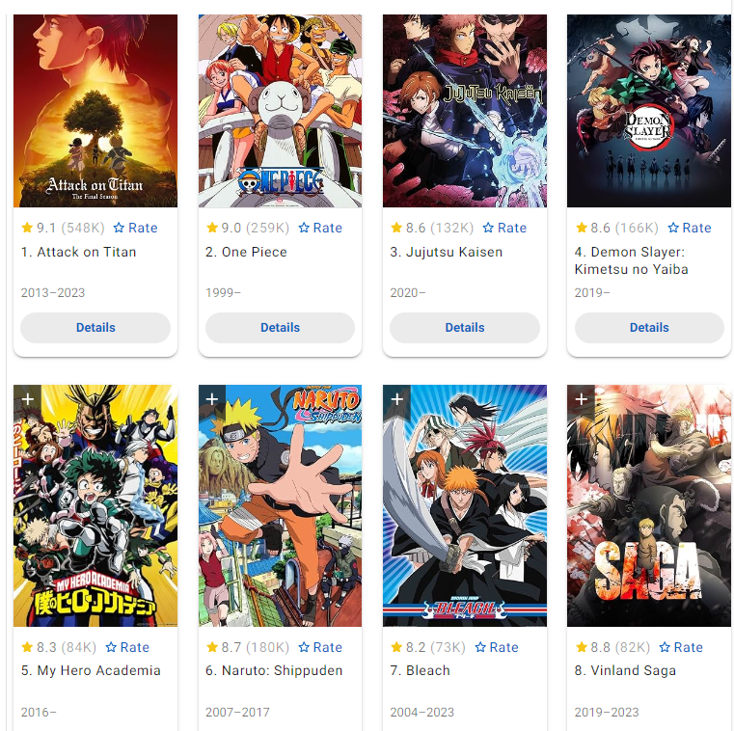
A CROWD FAVORITE
The most popular anime of any given season are typically action anime.
Because action is so popular, anime of many different genres incorporate action elements.
Typical Overlaps:
Adventure, Shonen, Fantasy

Slide 4
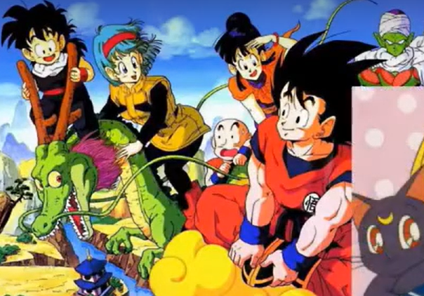
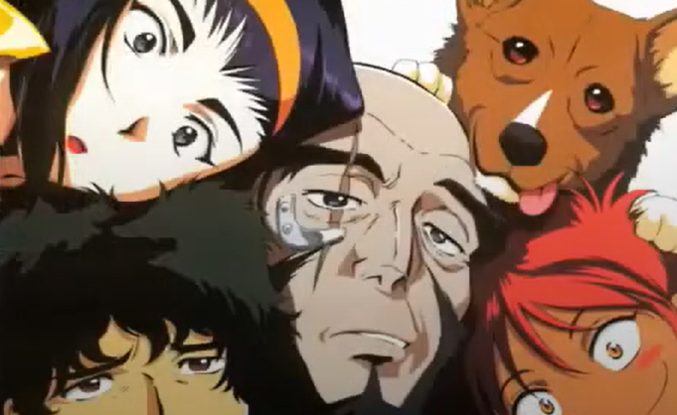
ALL
ACTION!

Slide 5
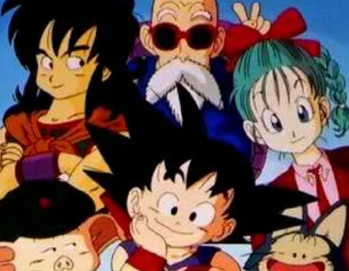
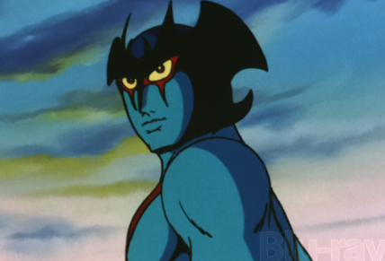
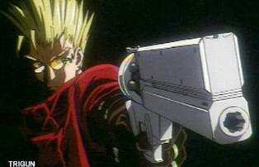
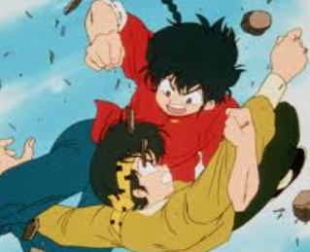
ACTION OVER TIME
Astro Boy (1963)
Devilman (1972)
Space Pirate Captain Harlock (1978)
Dragon Ball (1986)
Ranma ½ (1989)
Sailor moon (1992)
Trigun (1998)
Naruto (2002)

Slide 6
GOAL: PICK A SHOW
We are going to watch one episode of multiple shows this week (shows no one in the club has seen yet)
If there’s one we really enjoy as a group (and is short enough), we will watch it during every meeting until it’s done.
I sent out an email to everyone asking for suggestions. If I don’t get any responses, I’m just going with the shows I found.
And no, we are not watching more than 1 episode if there are people in the club who have already seen the show!

