Slide 1
FIRST MEETING
10/2/2024

Slide 2
WHAT IS ANIME?
Anime is a Japanese colloquialism that, in Japan, is virtually indistinguishable to animation of any kind.
However, in the non-Japanese world, this distinction is a lot more debated, but generally refers to animated cartoons from Japan.
Debating over what is and isn’t anime is not super important (some may disagree)
Anime covers a broad range of styles (more than what you think!)

Slide 3
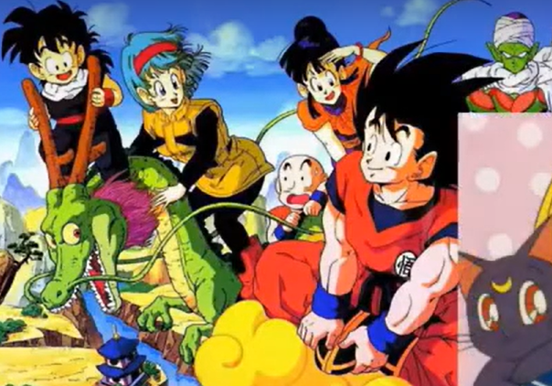
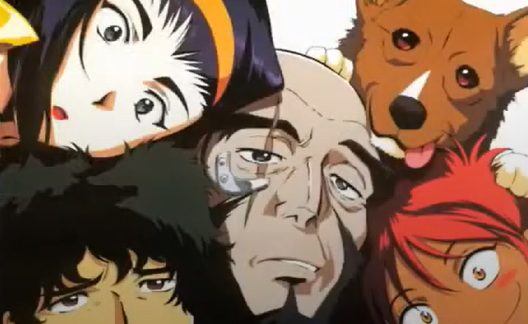

Slide 5
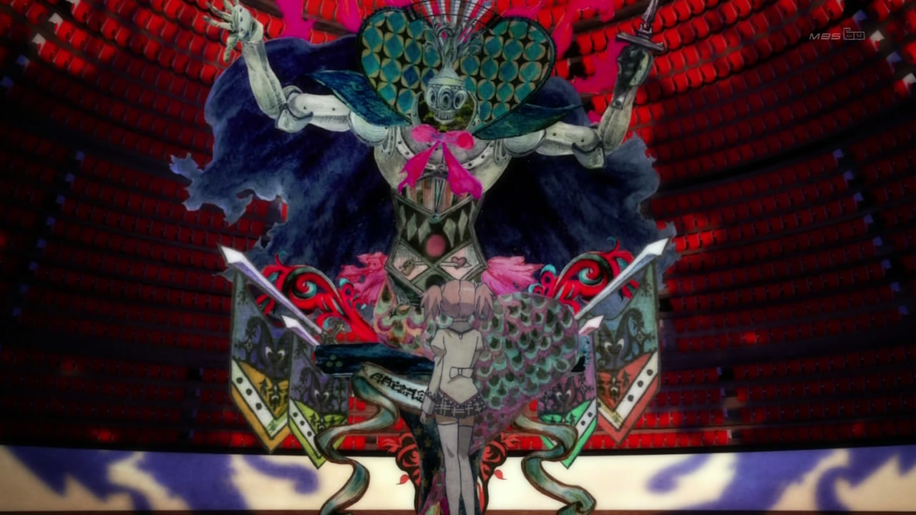
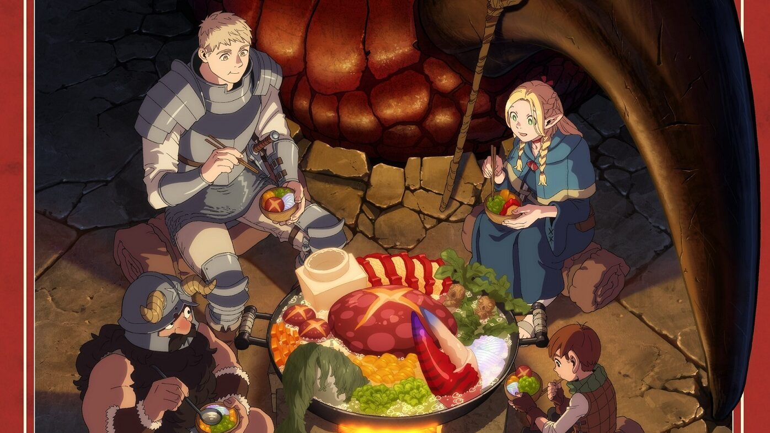
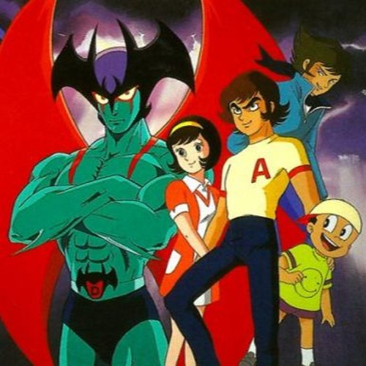

Slide 6
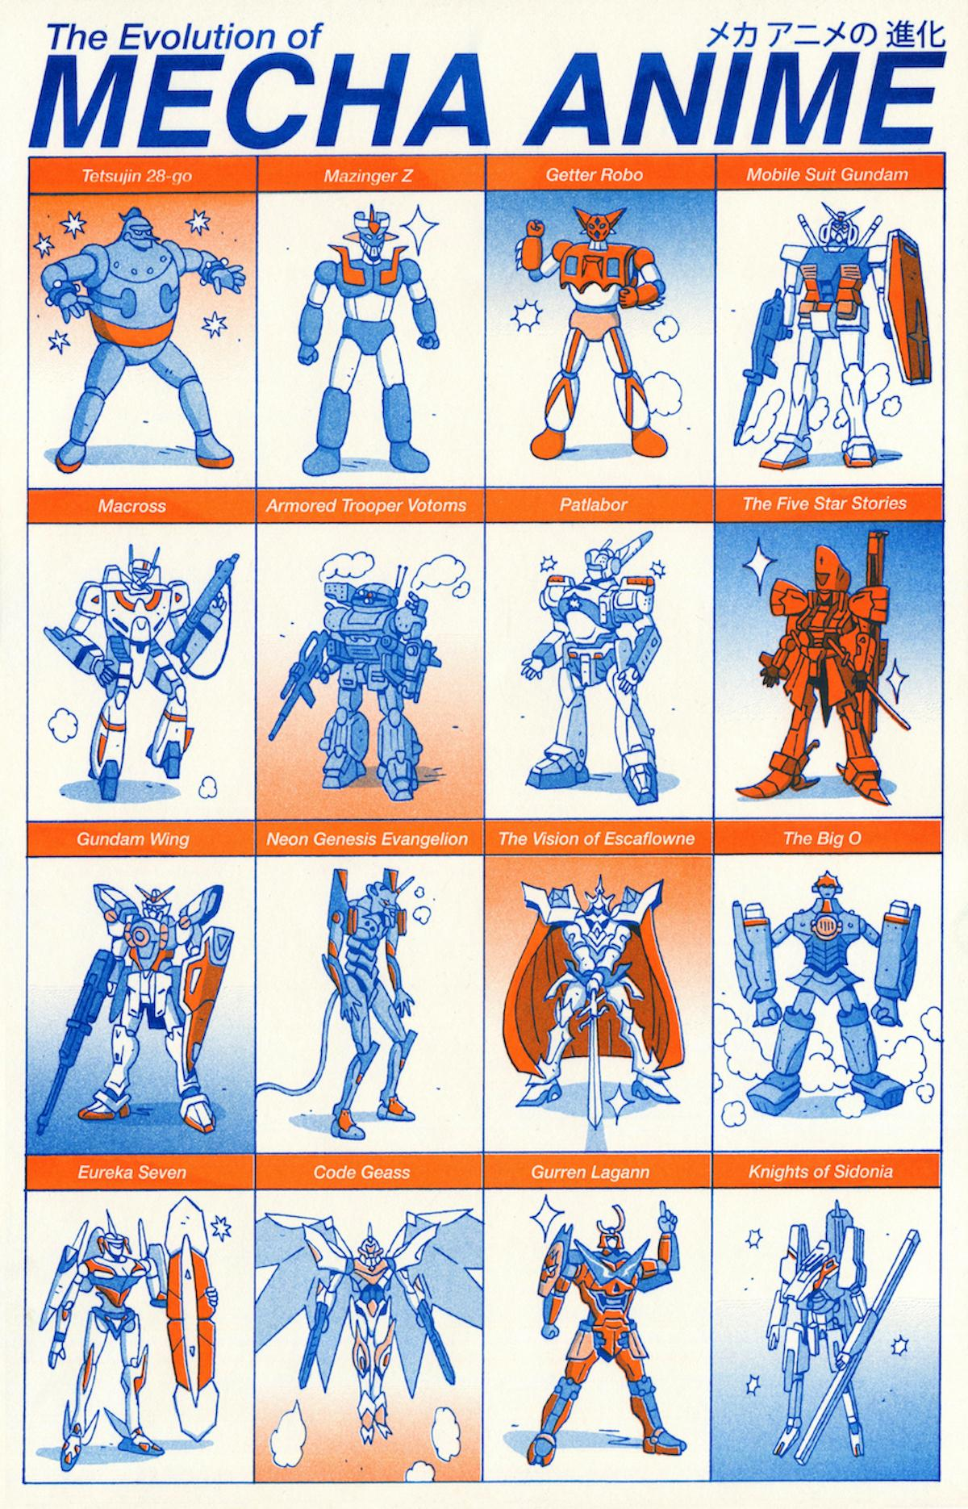
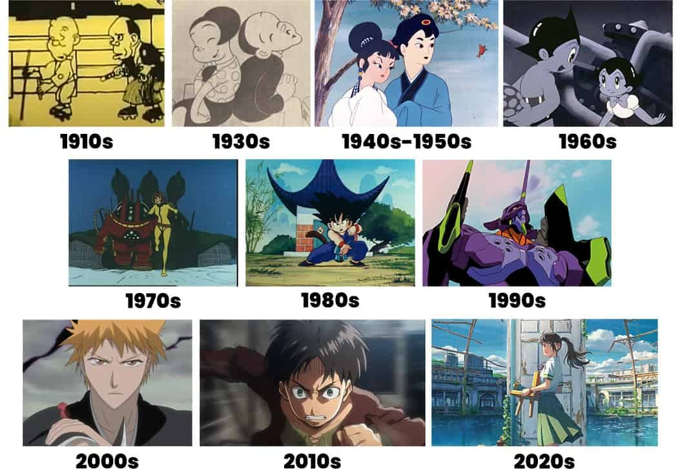
Anime is Always Changing!

Slide 7
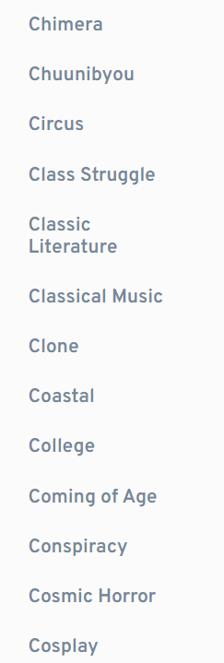
Anime Genres and Tags

Slide 8
Anime Genres and Tags

Slide 9
Anime Genres and Tags

Slide 10
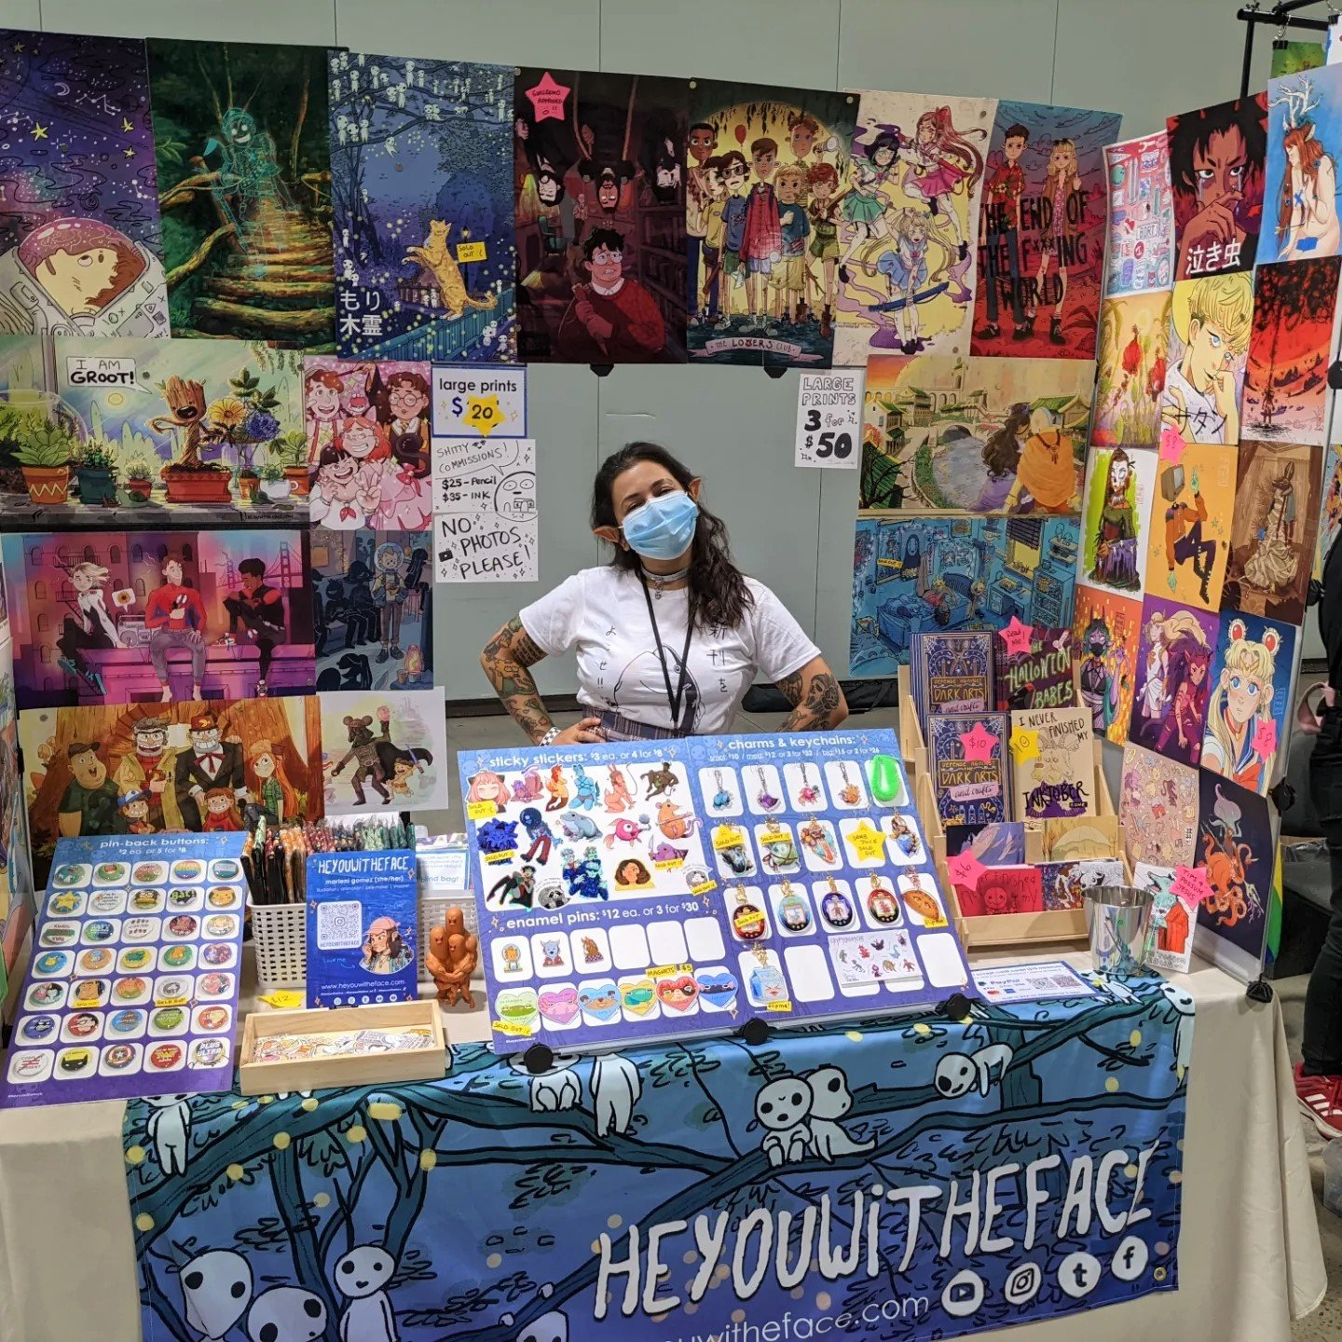
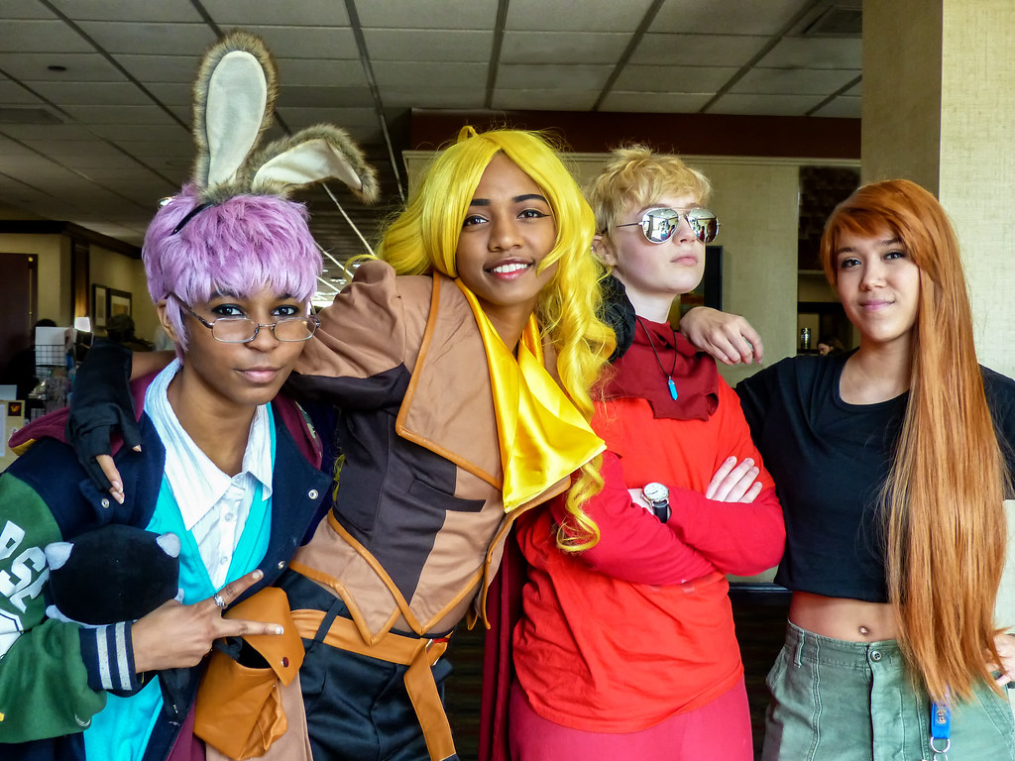
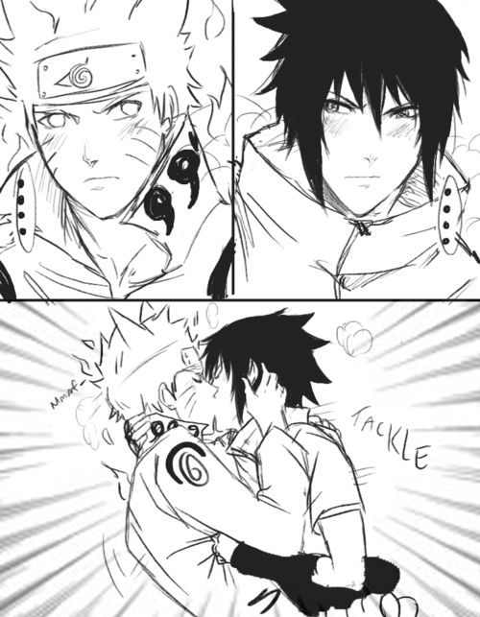
Anime Fandom is full of creativity!
Cosplay!
Fan Comics
Fan Fiction
YouTube Videos
Crafts
Fan Songs
AMV’s
Fan sites
And more!

Slide 11
STEP ONE: WATCHING ANIME

Slide 12
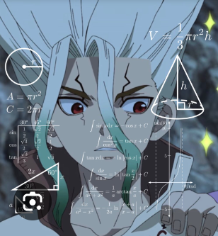
HOW MUCH ANIME CAN WE WATCH?
1 ep. Per lunch
2 lunches Per week
2 ep. Per meeting (after class)
= 4 episodes per week
a 12 episode season in 3 weeks
Goal: Watch shows we haven’t seen before, expand our knowledge of anime, and have fun
Limit: Ideally only 11-13 episode anime, unless we only watch 1 season (Death Note is a good example)

Slide 13
TODAY: ANIME ABOUT ANIME choose one episode

Slide 14
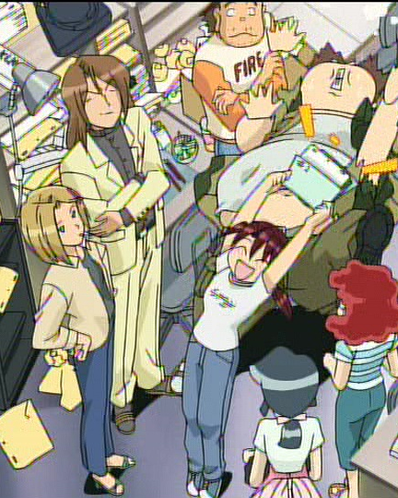
ANIMATION RUNNER KUROMI (OVA)
Kuromi just landed her dream job at the famous Studio Petit! The new head of the ultimate team of slackers, it’s up to her to finish "Time Journeys Episode 2," or fans everywhere will be let down. Will Kuromi's love of cartoons clean up this horrible mess... or make it even bigger?
Tags:
Parody
Work
Drawing
Slapstick
Female Protagonist
Primarily Adult Cast

Slide 15
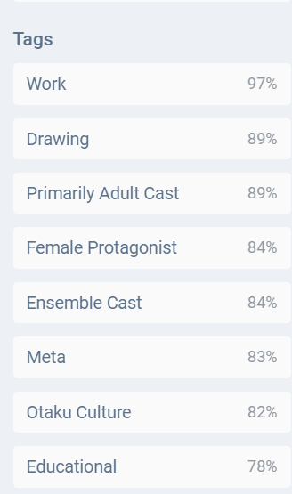
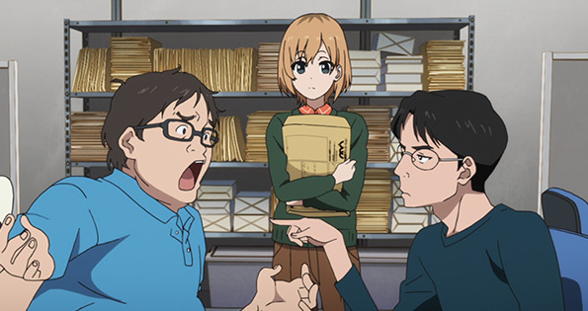
SHIROBAKO! EPISODE ONE
Five girls made an animated film and it was so much fun that they pledged to get jobs in animation! Now, two years later, Aoi, Shizuka, Ema, Misa and Midori have learned the truth about the anime industry.

Slide 16
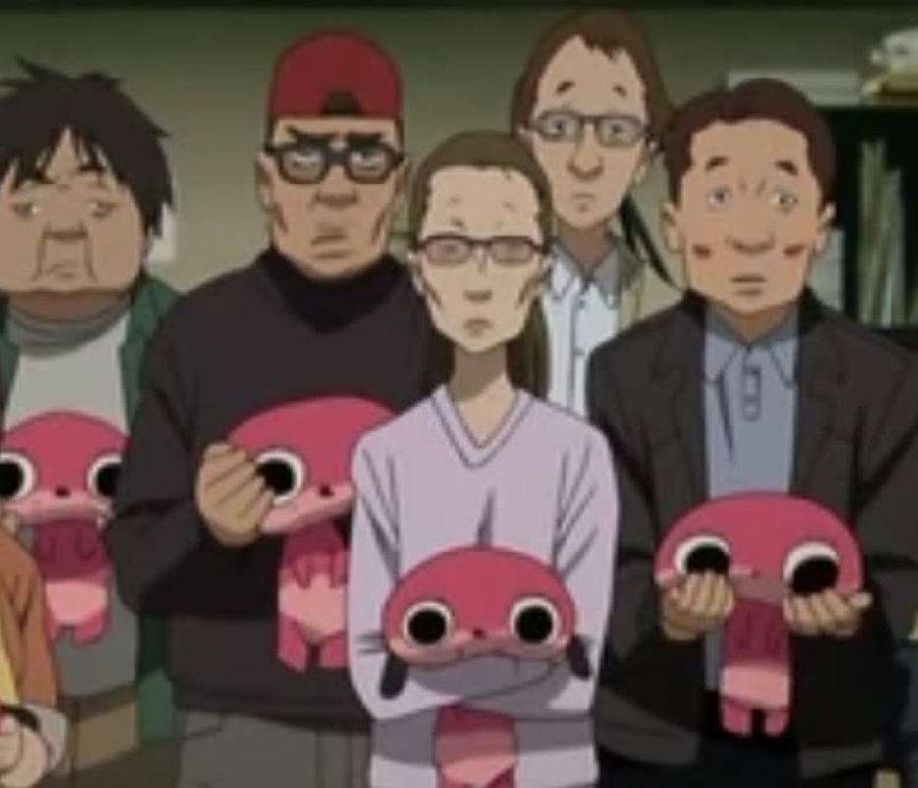
PARANOIA AGENT: EPISODE TEN
Just a normal anime episode about the production of an anime!
Nothing weird going on at all ☺

